Slide 1
CNENGR 228
Digital Electronics
Lecture 3 – Electronic Design Automation
Dr Zhongming Zhang
Zhongming.zhang@Lancaster.ac.uk
School of Engineering
Lancaster University

Slide 2
Objectives
  Understand the concept of Hardware Description Language (HDL)
  Recognize the steps for design of logic circuits using EDA tools
  Learn how to work with Quartus Prime software

Slide 3
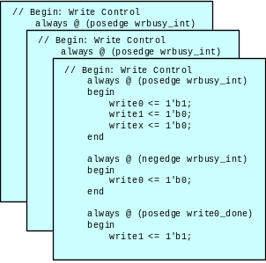
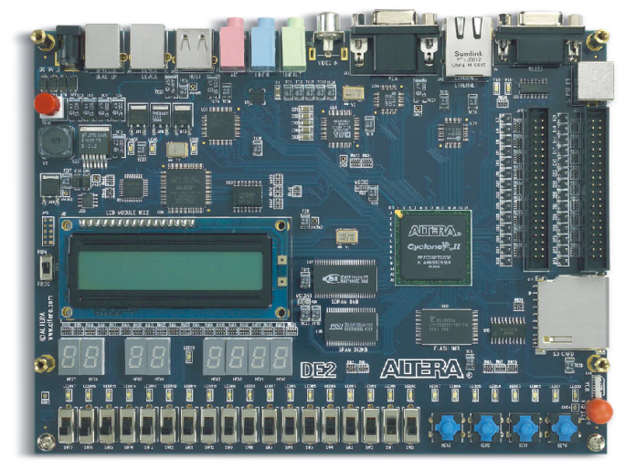
1. Electronic Design Automation (EDA) Tools
User’s design:
- Schematic
- Verilog HDL
- VHDL
FPGA design process
  Step 1: Design Entry
  Step 2: Synthesis
  Step 3: Physical Design (Fitting)
  Step 4: Verification
  Step 5: Testing
CAD
Tools
Altera Quartus Prime Software
A VHDL program can be transformed with a synthesis tool into a netlist, that is, a detailed gate-level implementation.
A fully integrated development tool
Altera DE-series board
Notes:
Behavioral level
Register transfer level
Gate level
Transistor level

Slide 4
1. Electronic Design Automation (EDA) Tools
FPGA design process
  Step 1: Design Entry
  Step 2: Synthesis
  Step 3: Physical Design (Fitting)
  Step 4: Verification
  Step 5: Testing
What is synthesis in digital design?
In electronics, logic synthesis is a process by which an abstract specification of desired circuit behaviour, typically at register transfer level (RTL), is turned into a design implementation in terms of logic gates, typically by a computer program called a synthesis tool.
Notes:
Behavioral level
Register transfer level
Gate level
Transistor level

Slide 5
1. Electronic Design Automation (EDA) Tools
(Abstraction levels)
Connecting transistors into circuits to build gates or other components is called transistor-level design
  Register
  transfer level
  Logic level
  Transistor level
Higher abstraction levels
Notes:
The more complex the building block, the higher the level of abstraction that the designer deals with

Slide 6
1. Electronic Design Automation (EDA) Tools
(Abstraction levels)
Designing combinational or sequential circuits involves circuits whose building blocks are primarily logic gates, and thus called logic-level design
  Register
  transfer level
  Logic level
  Transistor level
Higher abstraction levels
Notes:
The more complex the building block, the higher the level of abstraction that the designer deals with

Slide 7
1. Electronic Design Automation (EDA) Tools
(Abstraction levels)
Designing processors involves circuits whose building blocks are registers and other datapath components, and involves transferring data from registers, through other datapath components like adders, and back to registers, is thus called register-transfer level design or RTL design.
Any code that is synthesizable is called RTL code.
  Register
  transfer level
  Logic level
  Transistor level
Higher abstraction levels
Notes:
The more complex the building block, the higher the level of abstraction that the designer deals with

Slide 8
1. Electronic Design Automation (EDA) Tools
(Behavioural vs. Structural)
  Behavioural level – Designers may use the high-level programming constructs in a hardware description language, like VHDL or Verilog, to first capture the desired behaviour. This is known as behavioural-level design
  This level describes a system by concurrent algorithms (Behavioural). Each algorithm itself is sequential, that means it consists of a set of instructions that are executed one after the other. Functions, Procedures and Process blocks are the main elements. There is no regard to the structure.
  Behavioural modelling describes the behaviour of how the desired circuit might work.

Slide 9
1. Electronic Design Automation (EDA) Tools
(Behavioural vs. Structural)
  Structural refers to describing a design using module instances (especially for the lower-level building blocks such as AND gates and flip-flops), whereas behavioural refers to describing a design using Process blocks. Gate netlists are always structural, and RTL code is typically behavioural.
  Structural modelling describes how components are connected.

Slide 10
1. Electronic Design Automation (EDA) Tools
VHDL stands for VHSIC Hardware Description Language, and VHSIC in turn stands for Very High Speed Integrated Circuits. VHDL is an acronym for Very High Speed Integrated Circuit Hardware Description Language which is a programming language used to describe a logic circuit by function, data flow behaviour, or structure.
Notes:
Behavioral level
Register transfer level
Gate level
Transistor level

Slide 11
1. Electronic Design Automation (EDA) Tools
VHDL allows us to design a Digital design at Behaviour Level, Register Transfer Level (RTL), Gate level and at switch level. VHDL allows hardware designers to express their designs with behavioural constructs, deferring the details of implementation to a later stage of design in the final design.
Notes:
Behavioral level
Register transfer level
Gate level
Transistor level

Slide 12
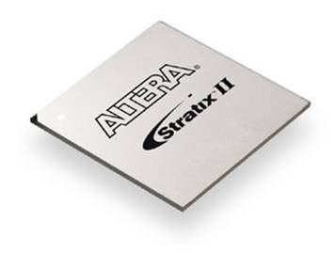
2. Quartus Prime CAD Software
Multiple Design Entries
ModelSim - Altera Edition
Simulation
Verilog,
VHDL
Synthesis
Placement
& Routing
Timing &
Power
Analysis
Assembler
Report
  Device Programming

Slide 13

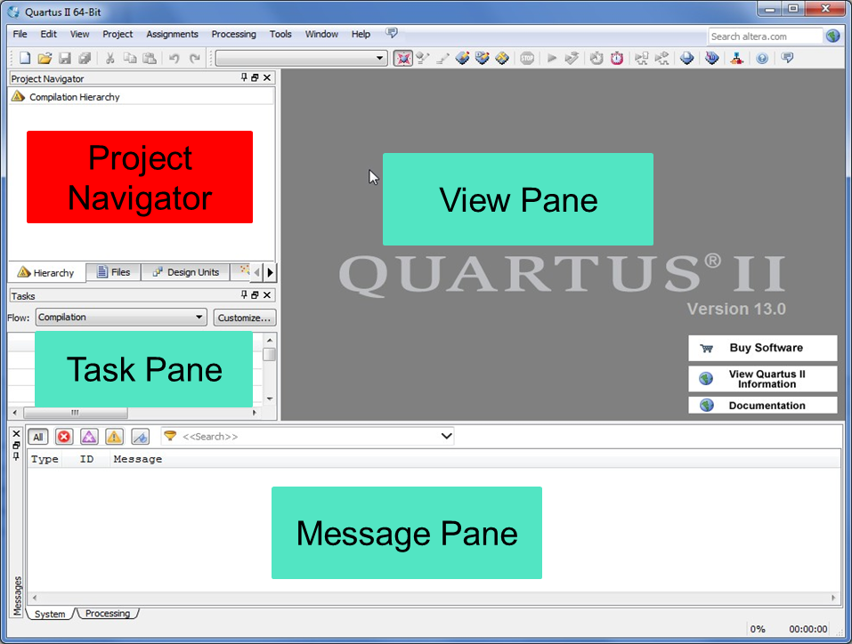
Step 1 - Design Entry
Design specifications
A thermometer produces a continuously varying voltage signal between 0V and 5V, where 0V represents 0 degrees, and 5V represents 100 degrees. The signal is fed to an analog-to-digital converter (ADC). The ADC produces an 8-bit binary number that is directly proportional to the temperature – “00000000” represents 0 degrees, each…..
- Sketch of circuit on paper
- HDL description
(VHDL, Verilog, …)
Design entry
Library IEEE;
use ieee.std_logic_1164.all;
use ieee.std_logic_unsigned.all;
entity RC5_core is
port(
clock, reset, encr_decr: in std_logic;
data_input: in std_logic_vector(31 downto 0);
data_output: out std_logic_vector(31 downto 0);
out_full: in std_logic;
key_input: in std_logic_vector(31 downto 0);
key_read: out std_logic;
);
end RC5_core;

Slide 14
Step 1 - Design Entry
Entering Design Constraints
  Assignment Editor (Assignment -> Assignment Editor)
  Pin Planner (Assignment -> Pin Planner)
  Time Quest Timing Analyzer (Tools -> Time Quest Timing Analyzer)
  Setting Dialogue Box (Assignment -> Setting)
  Chip Planner (Tools -> Chip Planner)

Slide 15
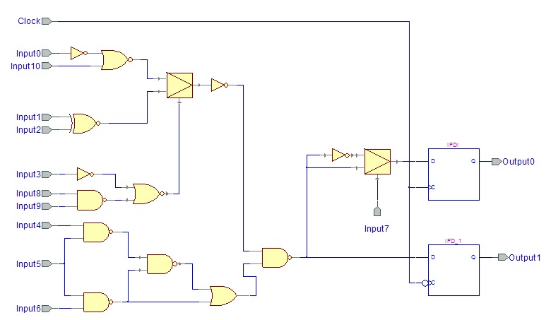
Step 2 - Synthesis
Synthesis
Netlist Generation
Gate Optimisation
LUT1
LUT0
LUT4
Technology Mapping
LUT2
FF1
LUT3
FF2
Post-synthesis functional netlist

Slide 16
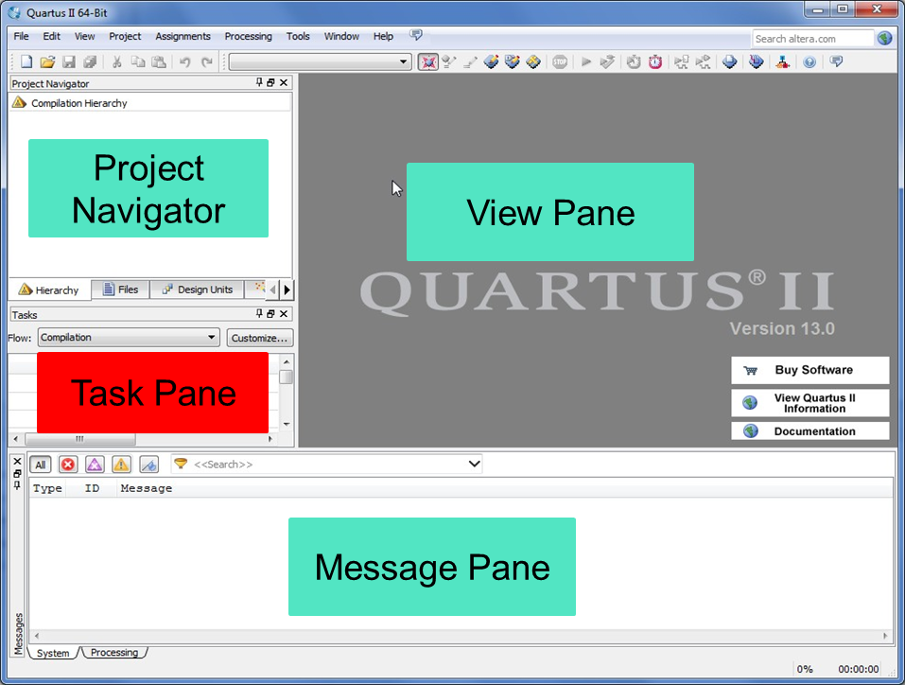
Step 2 - Synthesis
Incremental Synthesis
  Analysis and elaboration (Check syntax and semantic errors)
  Analyze current file (Check single design file)
Synthesis
Netlist Generation
Gate Optimization
Technology Mapping
Post-synthesis Functional Netlist

Slide 17
Step 3 - Physical Design-Fitting
Physical Design
Placement
LUT1
LUT0
Routing
LUT4
LUT2
FF1
Static Timing Analysis
LUT3
FF2

Slide 18
Step 3 - Physical Design-Fitting
Physical Design
Placement
LUT1
LUT0
Routing
LUT4
LUT2
FF1
Static Timing Analysis
LUT3
FF2

Slide 19
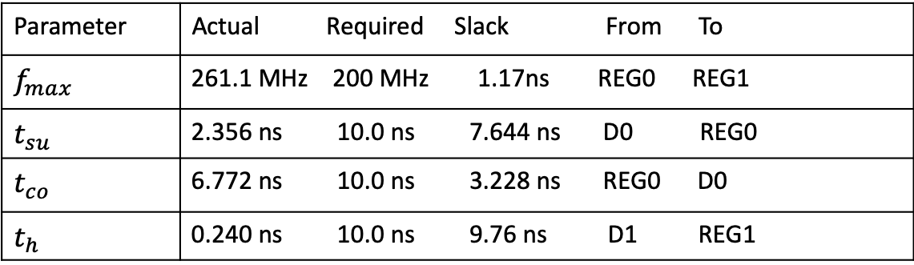
Step 4 - Verification
Test vector
Functional verification
Test vector
Timing verification
Parameter | Actual Required Slack From To
$$f_{max}$$ | 261.1 MHz 200 MHz 1.17ns REG0 REG1
$$t_{su}$$ | 2.356 ns 10.0 ns 7.644 ns D0 REG0
$$t_{co}$$ | 6.772 ns 10.0 ns 3.228 ns REG0 D0
$$t_{h}$$ | 0.240 ns 10.0 ns 9.76 ns D1 REG1

Slide 20
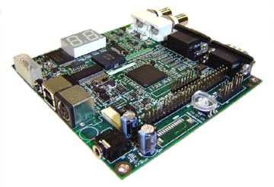
Step 5 - Testing
Testing
Assembler
Device Programming
On chip testing

Slide 21
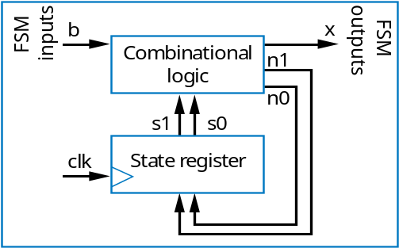
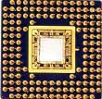
3. Digital Systems and HDLs
  Conventional approach
    Schematic entry: good for fairly small designs
  Possible for large design? NO!
b
Combinational Logic
x
n1
(~10 gates)
n0
s1
s0
clk
State register
(~1,000,000 gates)

Slide 22
3. Digital Systems and HDLs
Hardware Description Languages (HDL)
    Machine-readable textual languages for describing hardware
    Describe the design behaviour and not detailed gate level
    Gate-level logic is generated automatically by synthesis tools
    HDL is not a software programming language
// CombLogic
always @(State, B) begin
case (State)
S_Off: begin
X <= 0;
if (B == 0)
StateNext <= S_Off;
else
StateNext <= S_On1;
end
S_On1: begin
X <= 1;
StateNext <= S_On2;
end
S_On2: begin
X <= 1;
StateNext <= S_On3;
end
S_On3: begin
X <= 1;
StateNext <= S_Off;
end
endcase
end

Slide 23
3.1. Available HDLs
VHDL
  VHSIC* Hardware Description Language
  Defined in 1980s
  U.S. Dept. of Defense project / IEEE standard ("1076") in 1987
Verilog
  Defined in 1985 at Gateway Design Automation Inc
  C-like syntax
  IEEE standard ("1364") in 1995, revised in 2002, and again in 2005.
ENTITY DoorOpener IS
PORT (c, h, p: IN std_logic;
f: OUT std_logic);
END DoorOpener;
ARCHITECTURE Beh OF DoorOpener IS
BEGIN
PROCESS(c, h, p)
BEGIN
f <= NOT(c) AND (h OR p);
END PROCESS;
END Beh;
module DoorOpener(C,H,P,F);
input C, H, P;
output F;
reg F;
always @(C,H,P)
begin
F <= (~C) & (H | P);
end
endmodule
*VHSIC (Very High Speed Integrated Circuit)

Slide 24
3.1. Available HDLs
#include "systemc.h"
SC_MODULE(DoorOpener)
{
sc_in<sc_logic> c, h, p;
sc_out<sc_logic> f;
SC_CTOR(DoorOpener)
{
SC_METHOD(comblogic);
sensitive << c << h << p;
}
void comblogic()
{
f.write((~c.read()) & (h.read() | p.read()));
}
};
SystemC
  Defined in 2000s by several companies
  C++ libraries and macro routines
  IEEE standard ("1666") in 2005
  Excels for system-level; cumbersome for logic level
SystemVerilog
  System-level modeling extensions to Verilog
  IEEE Standard ("1800") in 2005
module DoorOpener(C,H,P,F);
input C, H, P;
output F;
reg F;
always @(C,H,P)
begin
F <= (~C) & (H | P);
end
endmodule

Slide 25
Summary
  Familiarity with Electronic Design Automation (EDA) Tools
  Steps of digital design using Quartus Prime software
  Introducing the concept of Hardware Description Language

